Slide 1
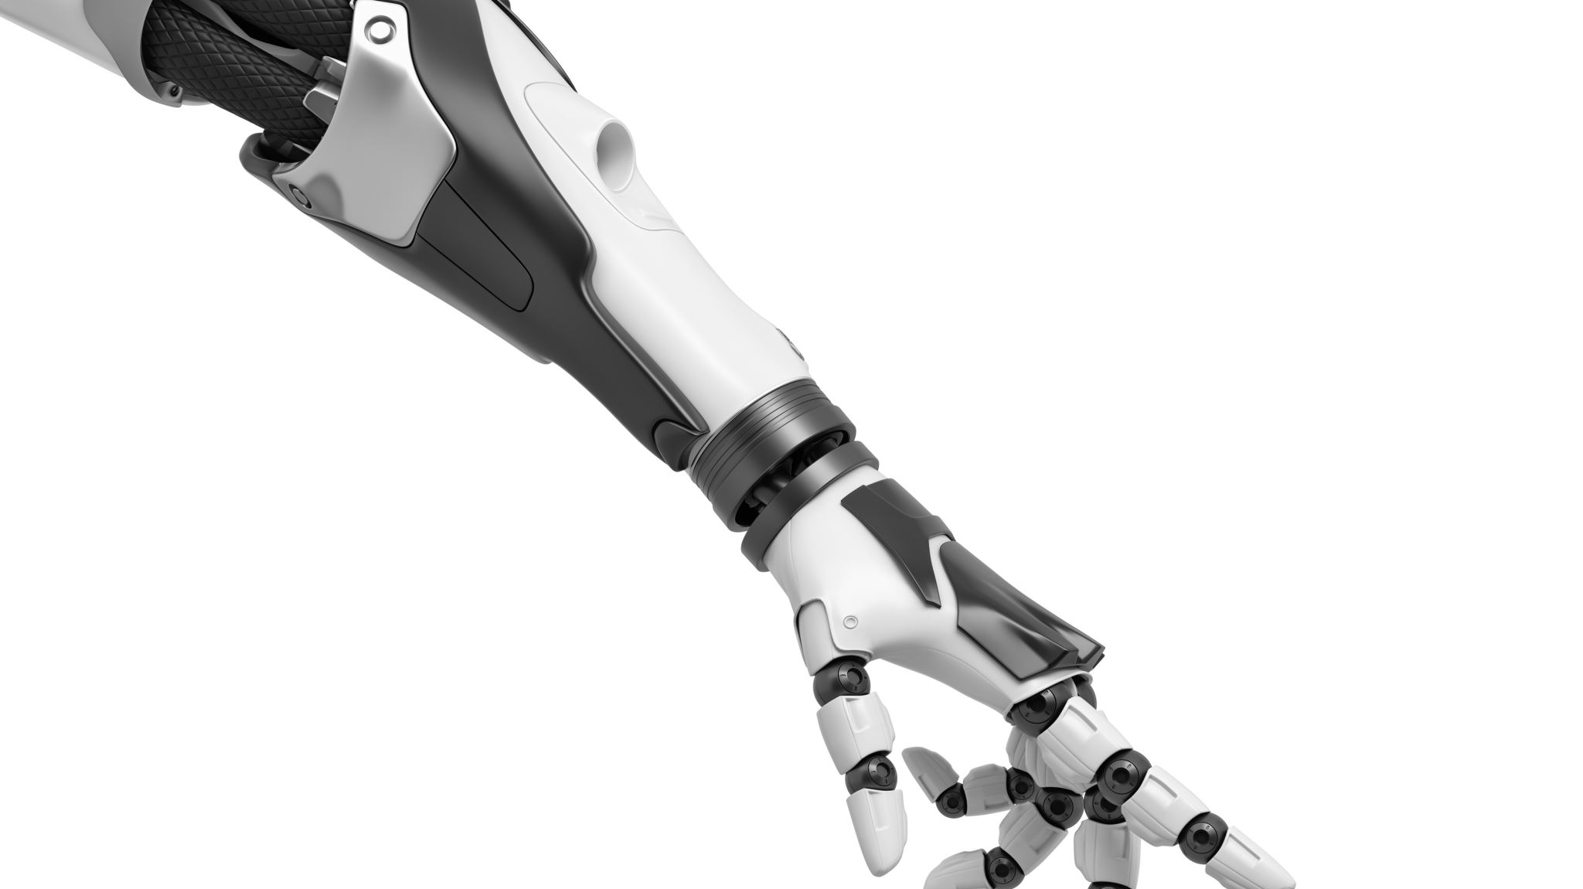
Robot Arm Project
Lecturer: Master, Lab Engineer Nguyen Hoang Vinh Khang
Teamwork of 3 students
Student 1: Le Hoang Khang _ Student ID: 20423010
Student 2: Nguyen Phuong Tu Anh_Student ID: 20423005
Student 3: Huynh Quoc Hung Student ID: 20422002

Slide 2

Outline
Introduction
Objective
Achievement
Difficulties + Solution
Future works

Slide 3
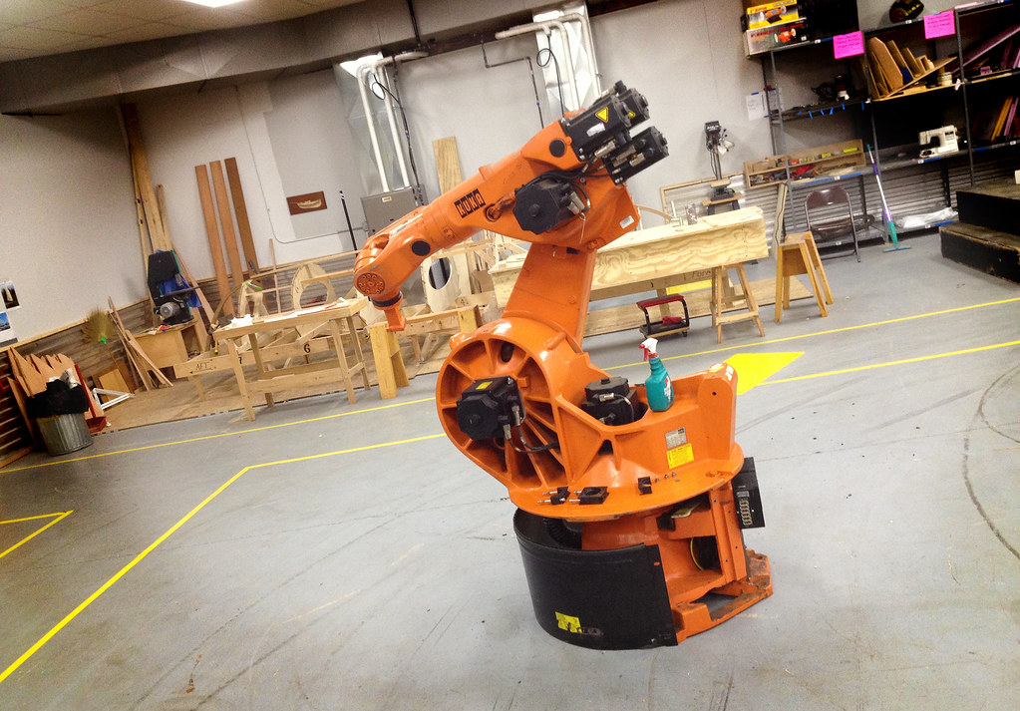
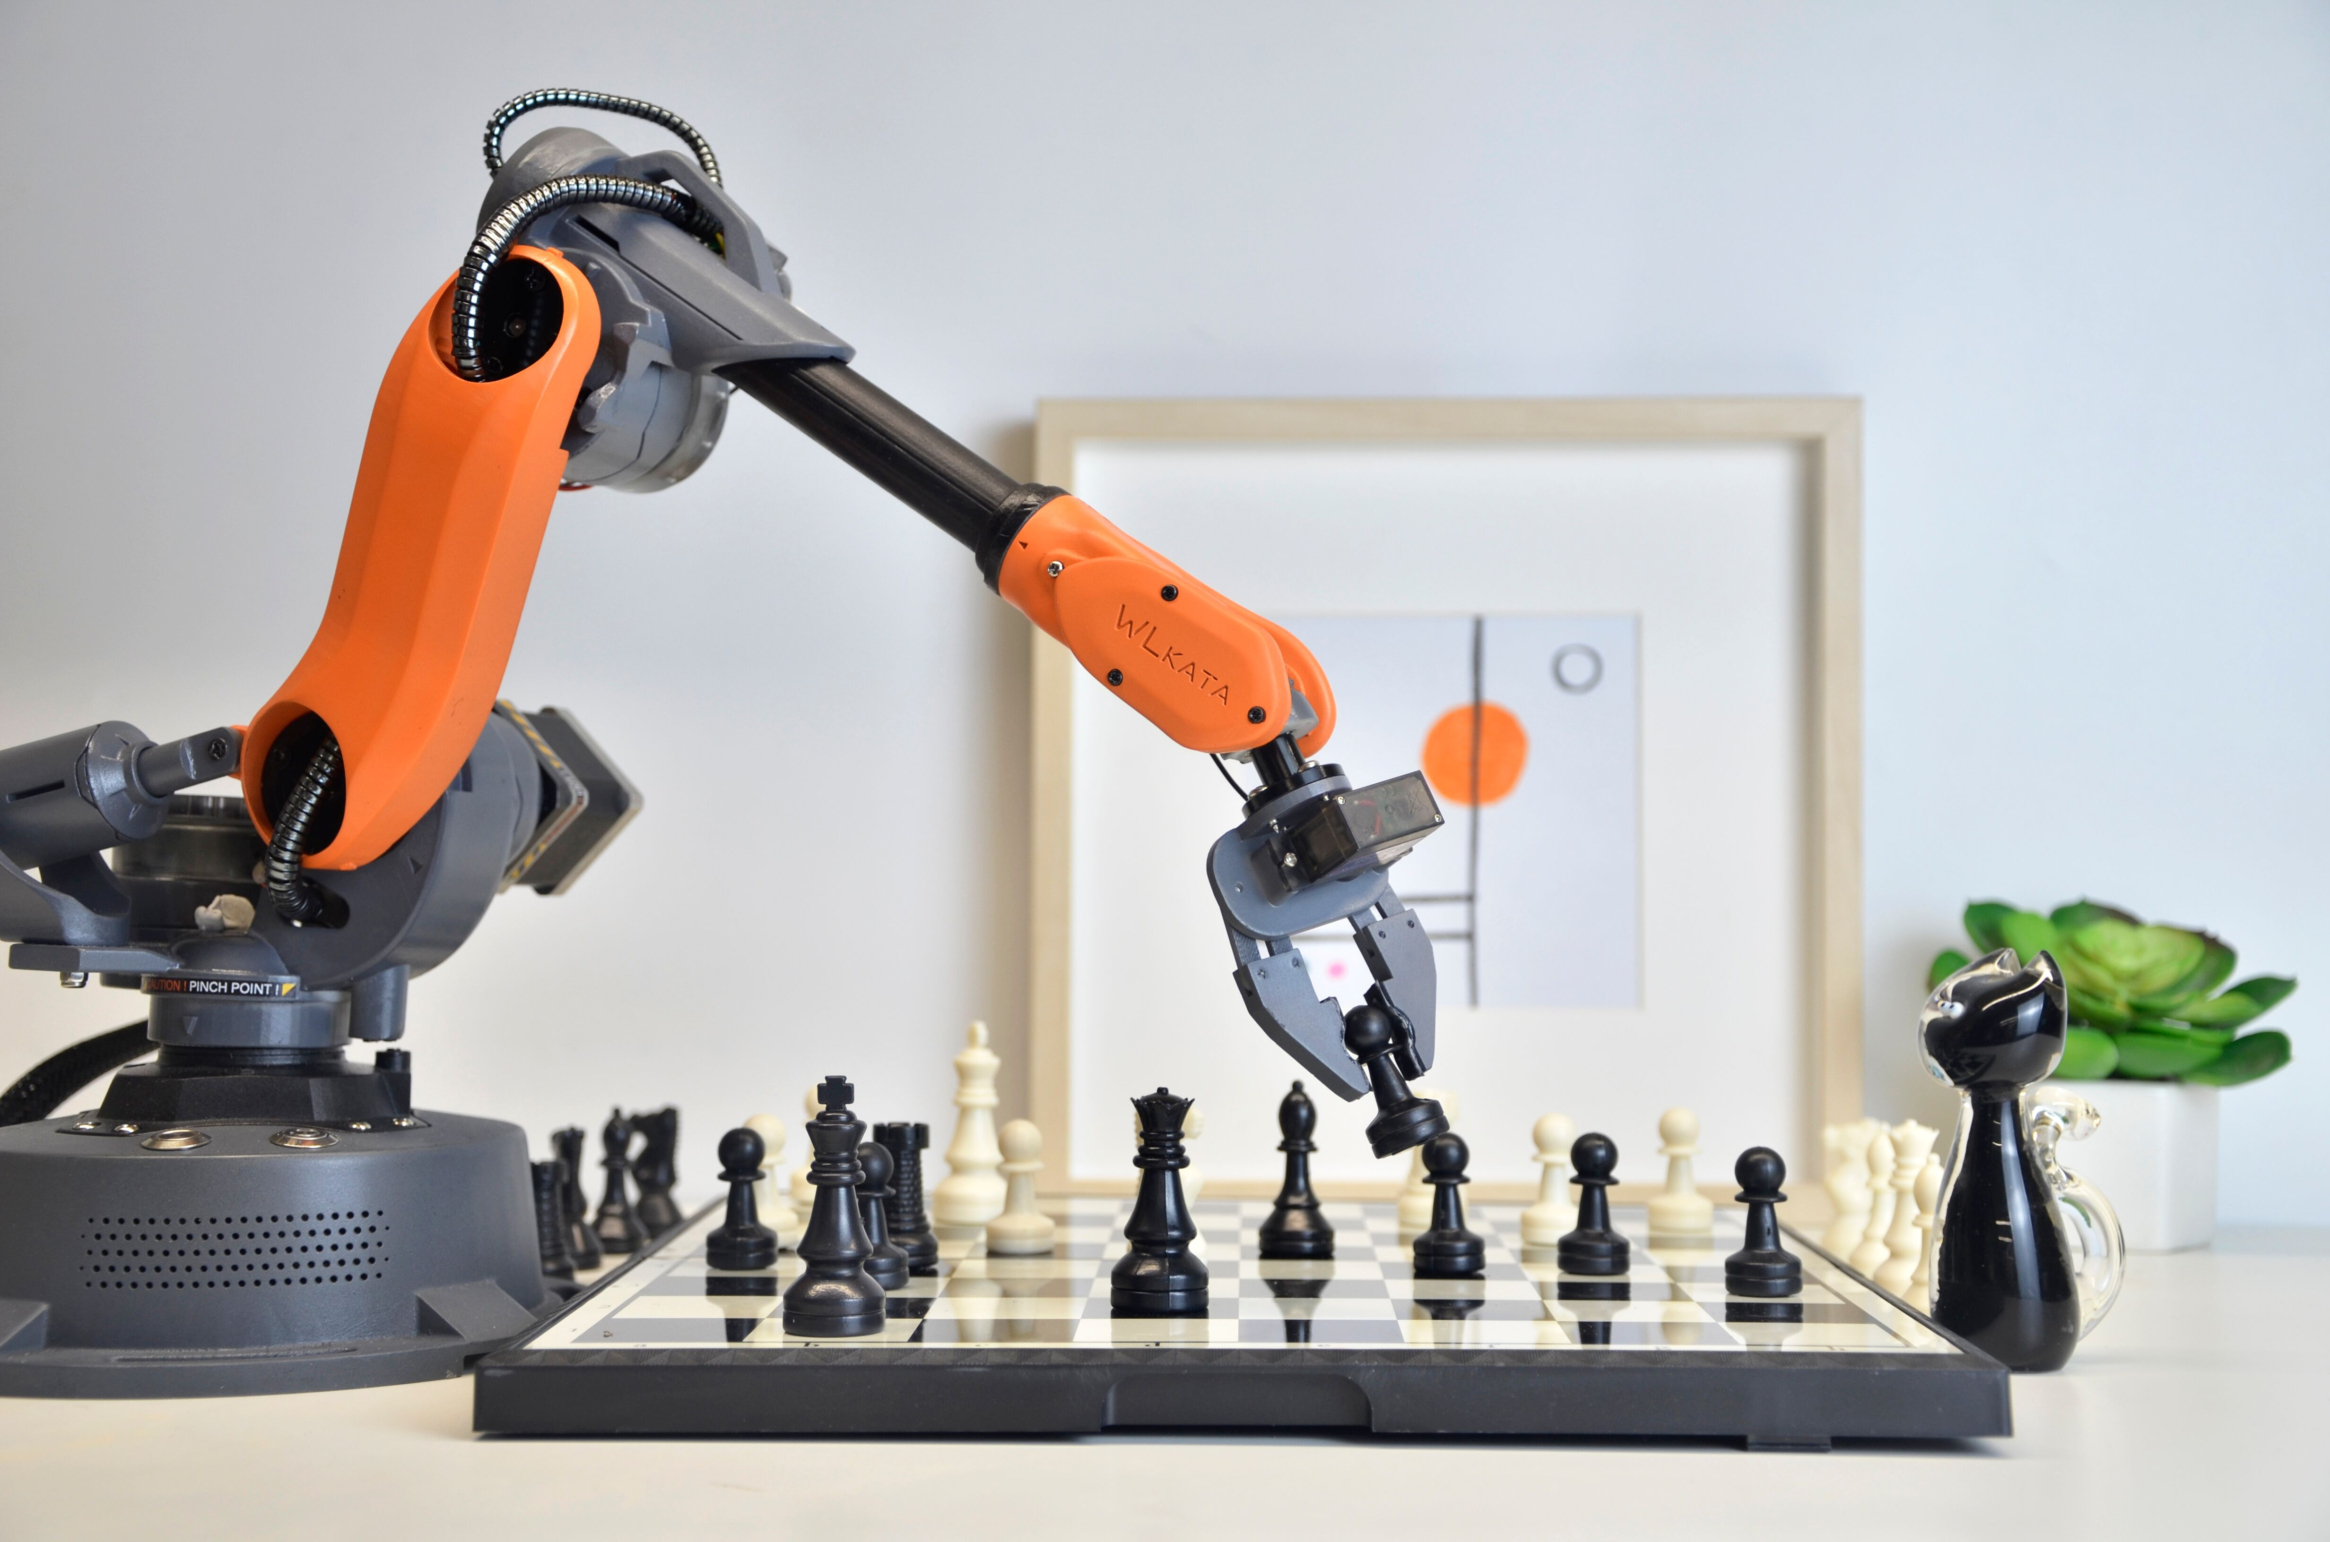
Introduction
Utilized in the industry with many application range from manufacturing to healthcare
This Photo by Unknown Author is licensed under CC BY-SA-NC

Slide 4
Objective
FreeRTOS: Synchronizes tasks, prioritizes joint movements, and manages sensor data collection for object manipulation.
Fuzzy Logic: Utilized for adaptive position control using encoder feedback, ensuring precise movement of the arm’s joints.
Kalman Filter: Enhances data accuracy by averaging ultrasonic sensor inputs and fusing multiple sensor data for stable object detection.
Machine Learning: Applied for speech/voice recognition, utilizing Edge Impulse software to build a robust ML model for hands-free operation.

Slide 5
Achievement
Contruct the forward and inverse kinematic system for the robot arm
Building a control system for stepper motor
Apply FreeRTOS to the system
Apply Kalman Filter to the sensor system
Collect data and construct the Machine Learning

Slide 6
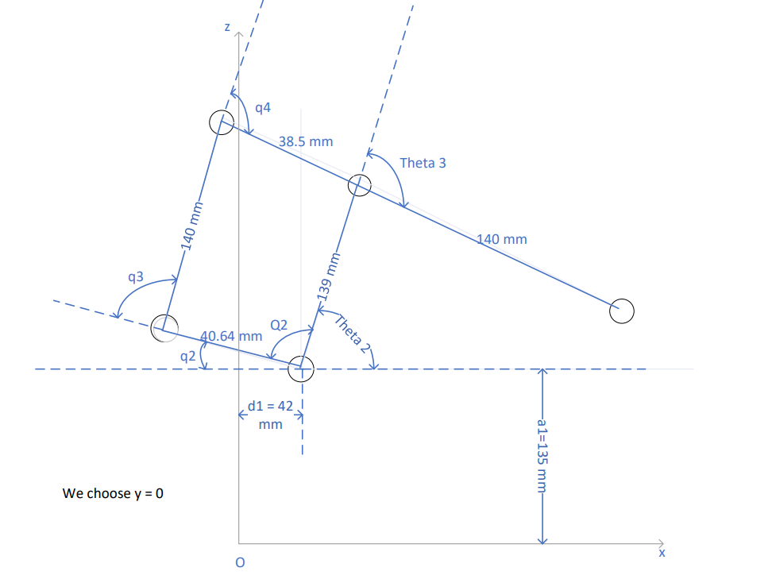
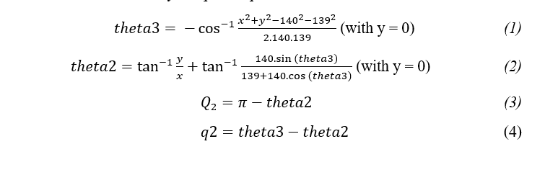
Forward and Inverse Kinematic

Slide 7
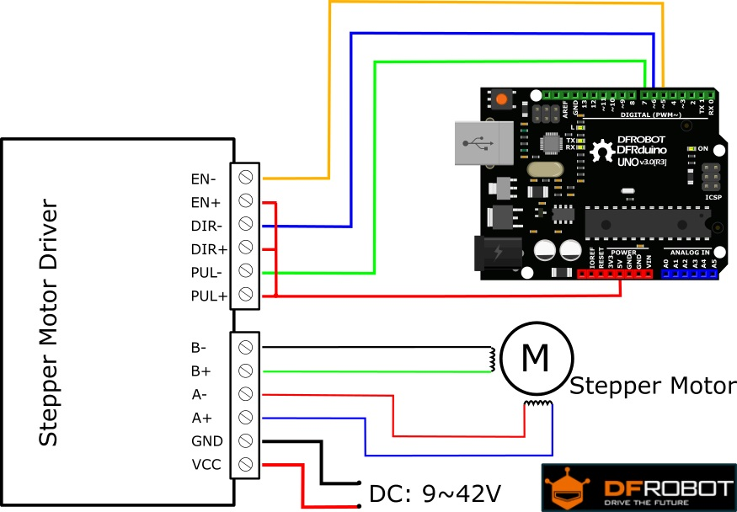
Control system for stepper motor
Driver TB6600 |  | Pin
Stepper Motor Driver 1 | PUL+ | GPIOD9
 | DIR+ | GPIOD8
Stepper Motor Driver 2 | PUL+ | GPIOB15
 | DIR+ | GPIOB14
Stepper Motor Driver 3 | PUL+ | GPIOB13
 | DIR+ | GPIOB12

Slide 8
Control system – Flow chart

Slide 9

Control system for stepper motor
void Generate_Pulses(Joint* Joint,uint32_t pulse_count, int16_t delay_us);
int16_t de_to_pul (int16_t degree);
Rotation shortest_rotation(float A, float B);
void control_Motor(Joint* Joint,float degreeto); //dùng cái này de dieu khien motor

Slide 10
FreeRTOS system

Slide 11
Kalman Filter

Slide 12
Machine Learning – Step to construct the embedded classifier library
Edge Impulse Machine Learning - Steps:
Data Collection
Collect audio from various sources.
Key takeaways:
Aim for at least 10 minutes of audio per class.
Collect both keywords and non-keywords (e.g., noise, unknown speech).
Ensure balanced data for each class.
Consider keyword complexity (e.g., multi-syllable words).
Feature Extraction
Use signal processing blocks to extract key features.
Important notes:
MFCCs are effective for representing keywords.
Neural Network Training
Pass extracted features into a neural network.
Significant points:
Neural networks learn to differentiate between audio classes.
Output probabilities for keywords and non-keywords.
Code Generation and Integration
Generate code with keyword classification capabilities.
Integrate code into target embedded device.

Slide 13
Difficulty
Errors in coding
Floating point error
Linker error between library
HCSR04 fluctuates a lot
Movement error in hardware
Forward and Inverse kinematic took a lot of time
Audio configure only take noise
Cannot store data in USB from STM32F4 discovery board

Slide 14
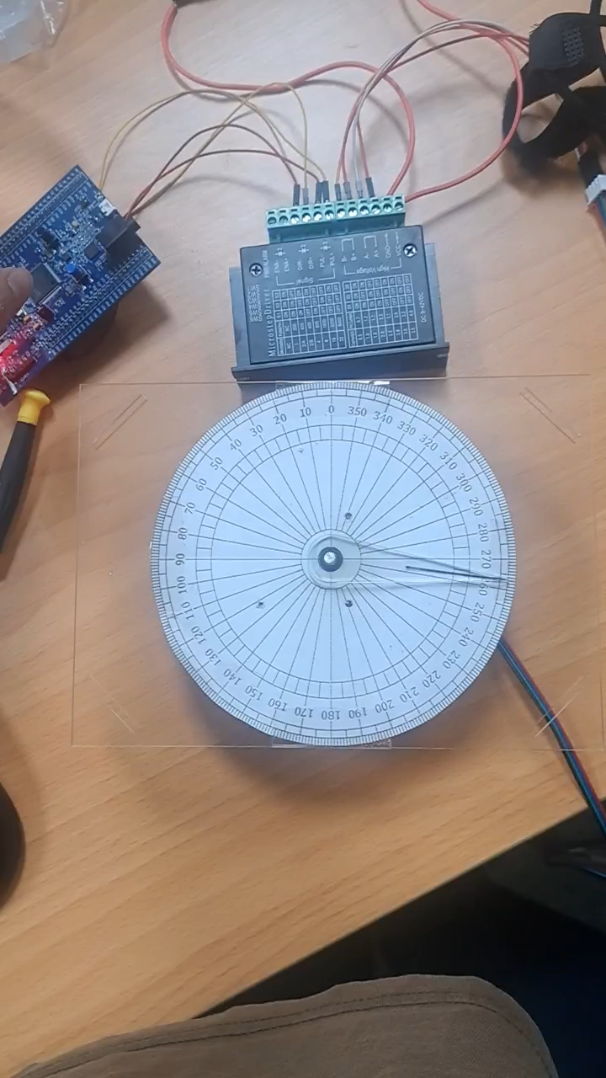
Float point error
Due to mismatch types of input between source file

Slide 15
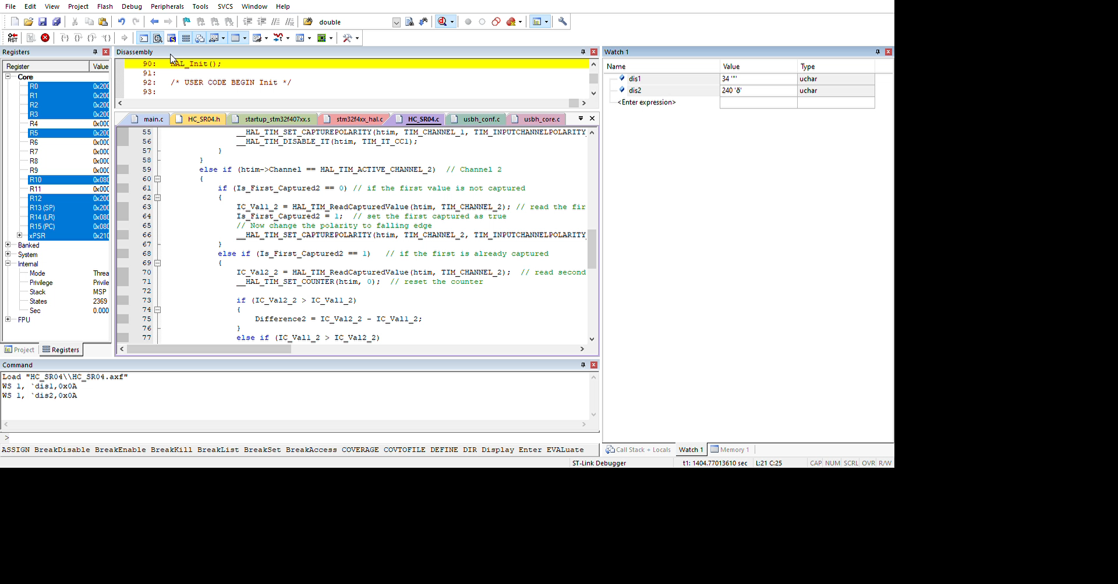
Fluctuations of HCSR04 sensor

Slide 16
Solution for fluctuation in HCSR04
Loop 10 times:
Get a distance measurement using HCSR04_GetDis()
If the distance is within the range [rangeMin, rangeMax]:
Increment validCount by 1
Store the current distance in validDis
If validCount is greater than 3:
Exit the loop early
Wait for 50 milliseconds (to stabilize the sensor reading)
After the loop:
If validCount is less than or equal to 3:
Set validDis to 0 (indicating an invalid result)
Set dis to the value of validDis for further processing

Slide 17
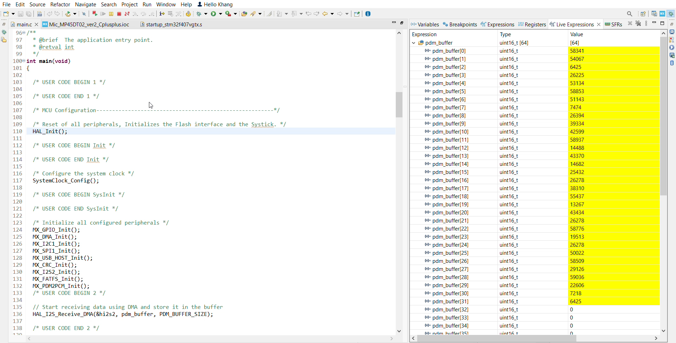
Fail in Capture Audio

Slide 18

Future Work
Apply audio with Machine Learning
Better movement control, apply Fuzzy Logic into the robot arm
=> Decide which part of arm moves first.

Slide 19

Thank you for listening

